Slide 1
Session 27: Multithreading
Dr. Naveen Kumar
Associate Professor
Amity Institute of Information Technology
Amity University Patna

Slide 2
Multithreading
1) The earlier days computer’s occupied only one program after completion of one program it is possible to execute another program is called uni-programming.
2) Whenever one program execution is completed then only second program execution will be started; such type of execution is called co-operative execution, in this type of execution we are having lot of disadvantages.
Most of the times memory will be wasted.
CPU utilization will be reduced because only program allow executing at a time.
The program queue is developed on the basis of co operative execution

Slide 3
To overcome above problem a new programming style will be introduced is called multiprogramming.
1) Multiprogramming means executing the more than one program at a time.
2) All these programs are controlled by the CPU scheduler.
3) CPU scheduler will allocate a particular time period for each and every program.
4) Executing several programs simultaneously is called multiprogramming.
5) In multiprogramming a program can be entered in different states.
a. Ready state. b. Running state.
c. Waiting state.
6) Multiprogramming mainly focuses on the number of programs.

Slide 4
Advantages of multiprogramming
The main advantage of multithreading is to provide simultaneous execution of two or more parts of a application to improve the CPU utilization.
CPU utilization will be increased.
Execution speed will be increased and response time will be decreased.
CPU resources are not wasted.

Slide 5
Thread
1) Thread is nothing but separate path of sequential execution.
2) The independent execution technical name is called thread.
3) Whenever different parts of the program executed simultaneously that each and every part is called thread.
4) The thread is light weight process because whenever we are creating thread it is not occupying the separate memory it uses the same memory. Whenever the memory is shared means it is not consuming more memory.
5) Executing more than one thread simultaneously at a time is called multithreading.

Slide 6
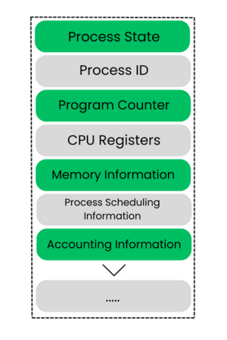

Slide 7
About main Thread
When a java program starts, one Thread is running immediately that thread is called main thread.
It is used to create a new Thread(child Thread).
It must be the last thread to finish the execution because it perform various actions.
It is possible to get the current thread reference by using currentThread() method it is a static public method present in Thread class.
class CurrentThreadDemo {
public static void main(String[] arhgs) {
Thread t=Thread.currentThread();
System.out.println("current Thread--->"+t); //change the name of the thread
t.setName(”amity");
System.out.println("after name changed---> "+t);
} };

Slide 8
Single threaded model
class Test {
public static void main(String[] args) { //begins
System.out.println("Hello World!");
System.out.println("hi amitian"); //body
System.out.println("hello Amity Patna");
} //end
In the above program only one thread is available is called main thread, to know the name of the thread we have to execute the fallowing code.
The main important application areas of the multithreading are
1. Developing video games 2. Implementing multimedia graphics. 3. Developing animations

Slide 9
A thread can be created in two ways:-
1) By extending Thread class.
2) By implementing java.lang.Runnable interface

Slide 10
Create thread extending Thread class
Step 1:- Our normal java class will become Thread class whenever we are extending predefined Thread class.
class MyThread extends Thread { }; Step 2:- override the run() method to write the business logic of the Thread( run() method present in Thread class).
class MyThread extends Thread {
public void run() {
System.out.println("business logic of the thread");
System.out.println("body of the thread");
} }
Step 2:- Create user defined Thread class object.
MyThread t=new MyThread();
Step 3:- Start the Thread by using start() method of Thread class. t.start();

Slide 11
class MyThread extends Thread //defining a Thread {
//business logic of user defined Thread
public void run() {
for (int i=0;i<10;i++) {
System.out.println("userdefined Thread");
} }
}
class ThreadDemo {
public static void main(String[] args) {
MyThread t=new MyThread();
t.start(); //MyThread execution started //business logic of main Thread
for (int i=0;i<10;i++) {
System.out.println("Main Thread");
}
} }

Slide 12
Flow of execution
1) Whenever we are calling t.start() method then JVM will search start() method in the MyThread class. If not available then JVM will execute parent class(Thread) start() method.
Thread class start() method responsibilities
a. User defined thread is registered into Thread Scheduler then only decide new Thread is created.
b. The Thread class start() automatically calls run() to execute logics of user defined Thread.
Thread Scheduler:-
Thread scheduler is a part of the JVM. It decides thread execution.
Thread Scheduler mainly uses two algorithms to decide Thread execution.
1) Preemptive algorithm.
2) Time slicing algorithm.

Slide 13
Thread Scheduler
We can’t expect exact behavior of the thread scheduler it is JVM vendor dependent. So we can’t say expected output of the multithreaded examples we can say the possible outputs.
Preemptive scheduling:-
In this highest priority task is executed first after this task enters into waiting state or dead state then only another higher priority task come to existence.
Time Slicing Scheduling:-
A task is executed predefined slice of time and then return pool of ready tasks. The scheduler
determines which task is executed based on the priority and other factors.

Slide 14
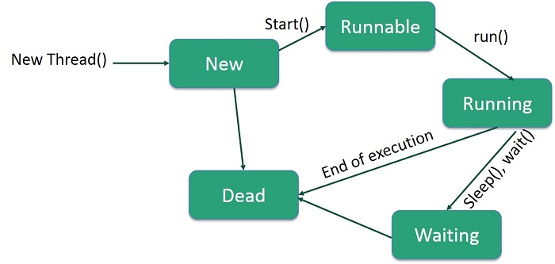

Slide 15
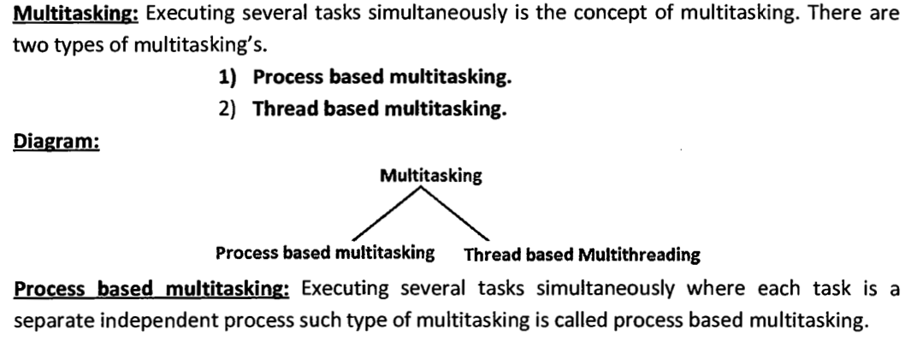
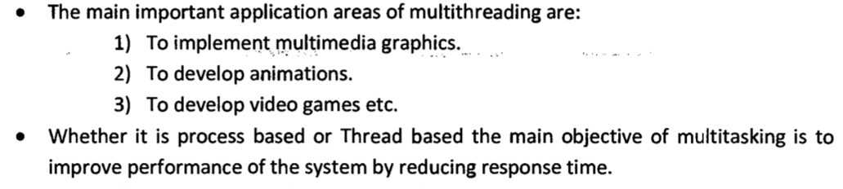

Slide 16
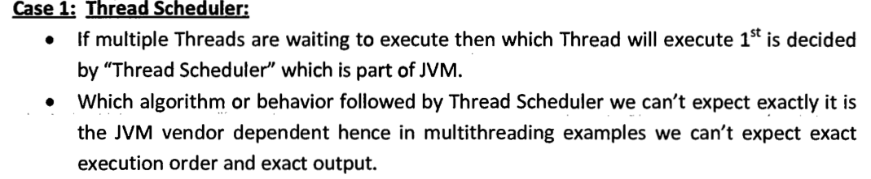
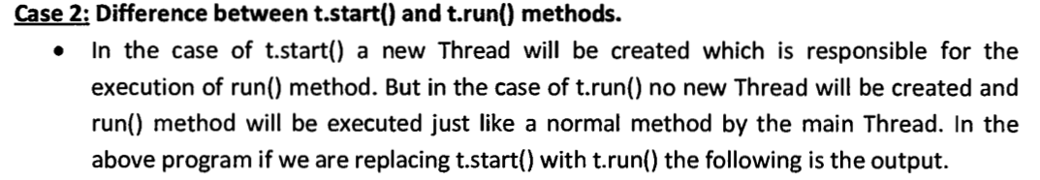

Slide 17
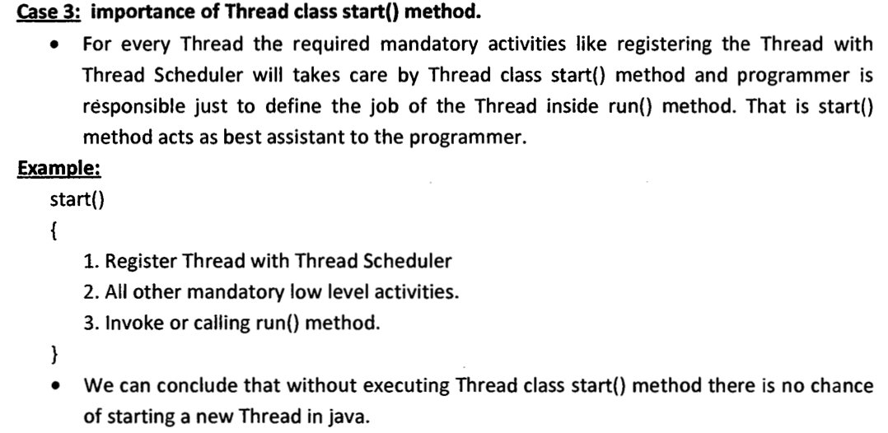
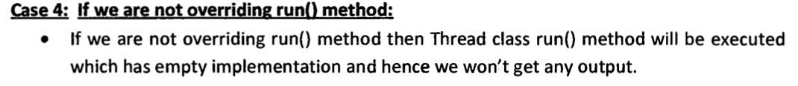

Slide 18
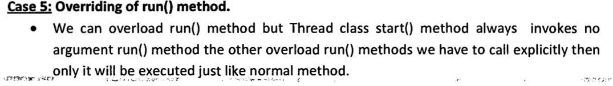
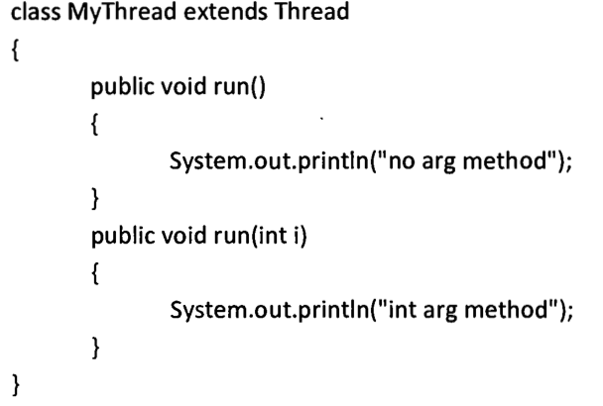

Slide 19
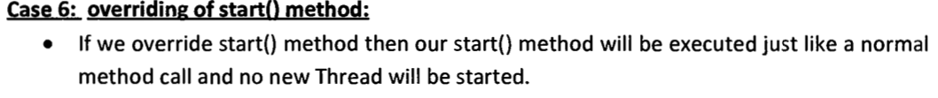
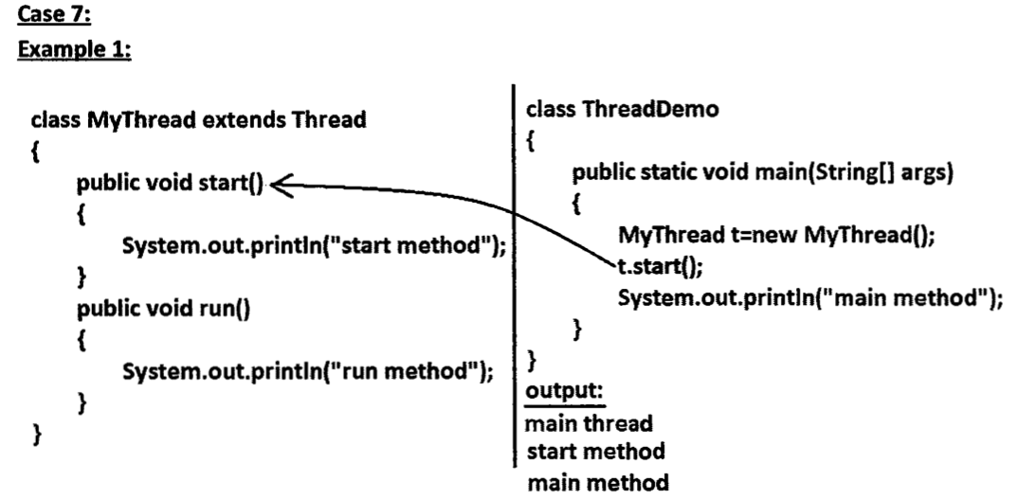

Slide 20
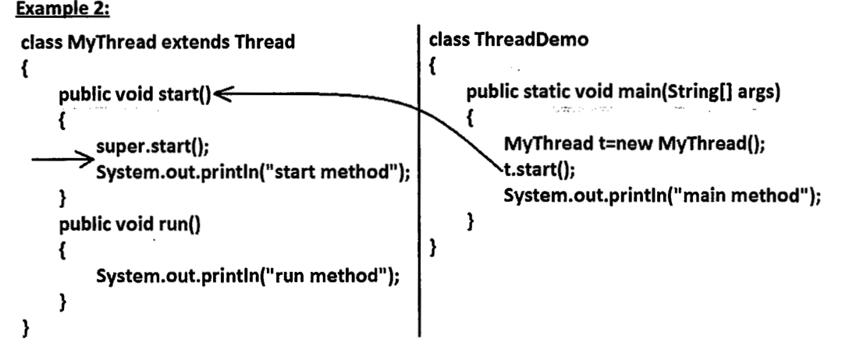

Slide 21
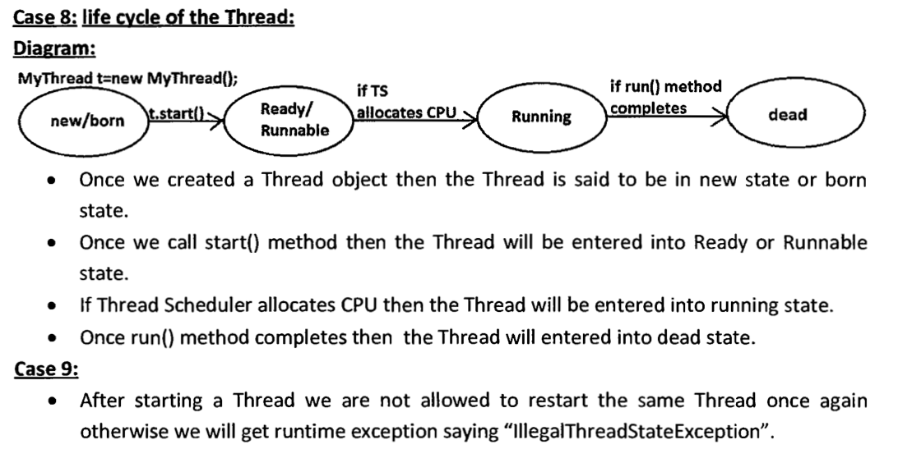
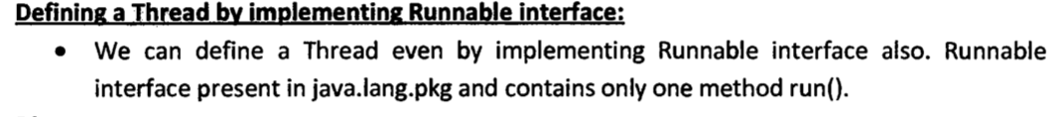

Slide 22
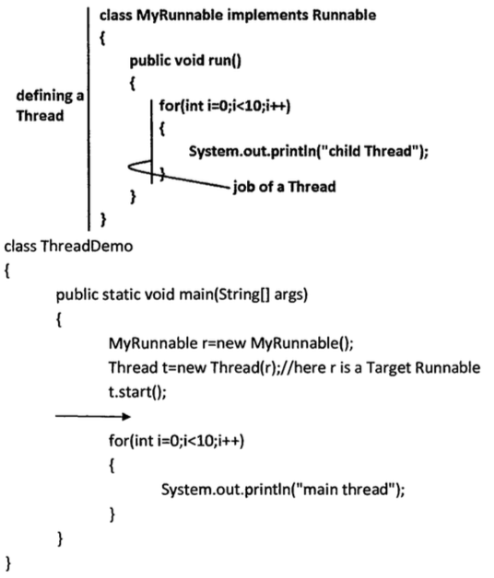

Slide 23
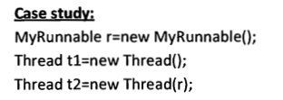







Slide 24
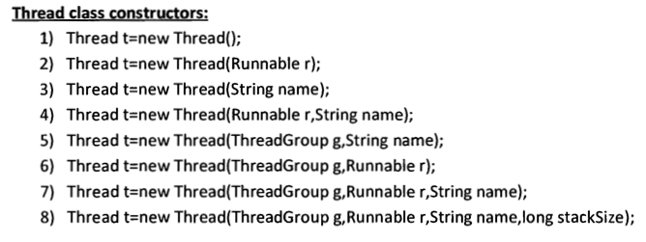

Slide 25
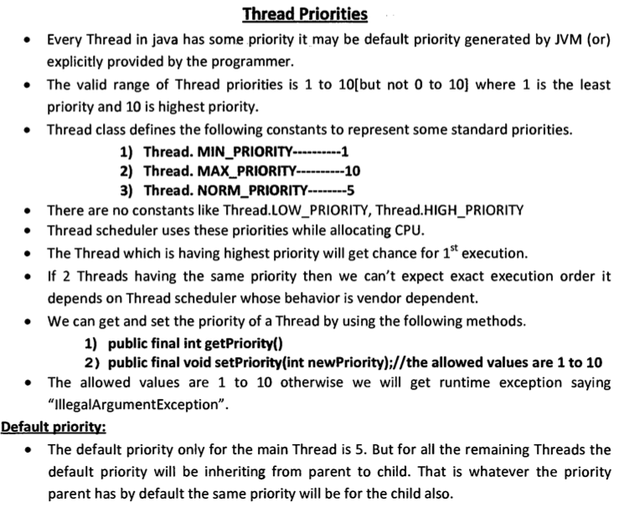

Slide 26
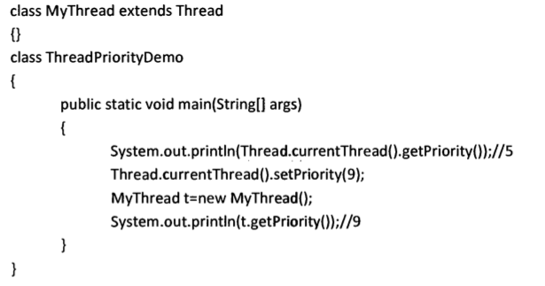

Slide 27
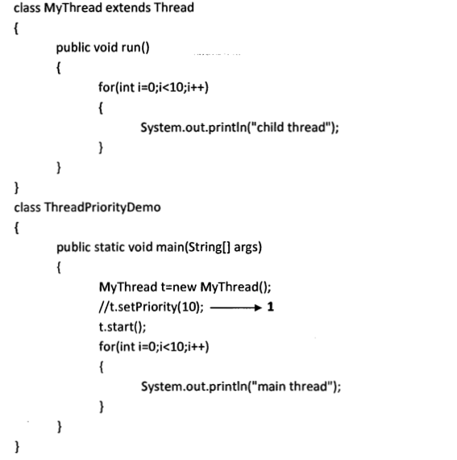

Slide 28
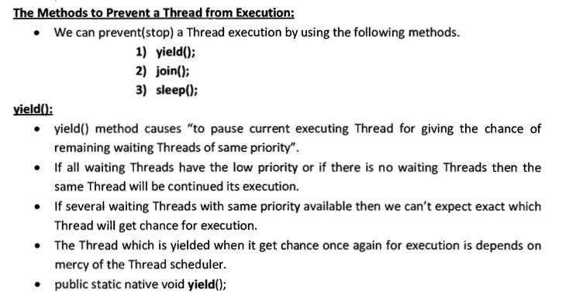
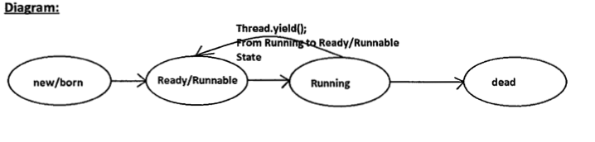

Slide 29
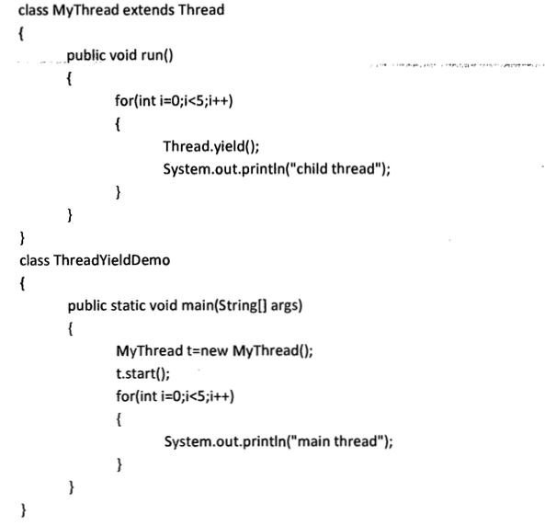

Slide 30
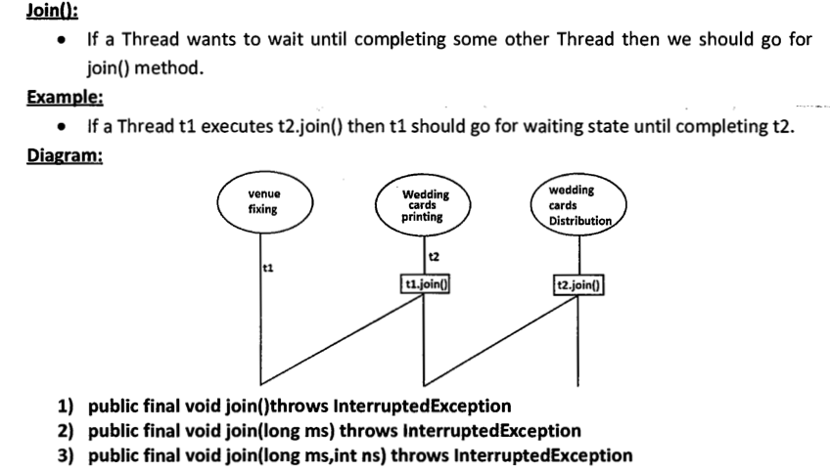

Slide 31
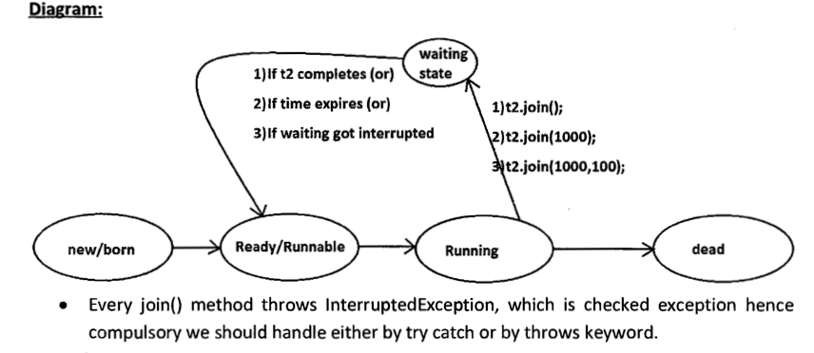

Slide 32
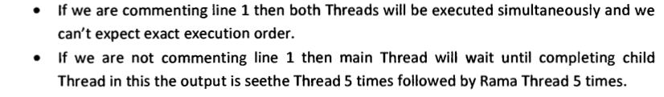
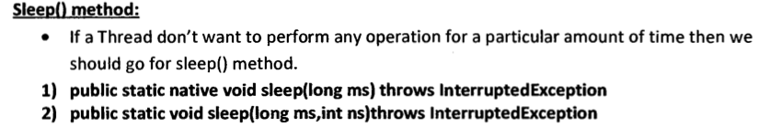
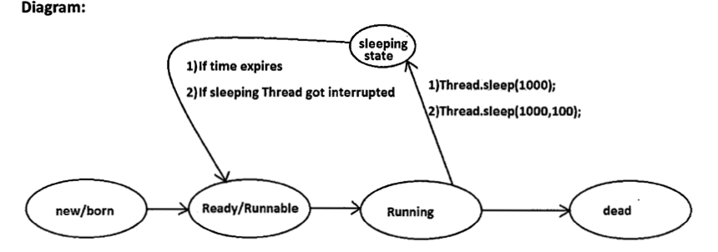

Slide 33

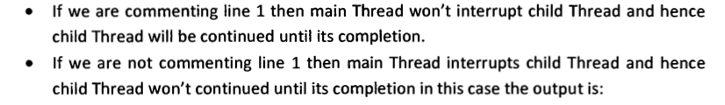


Slide 34
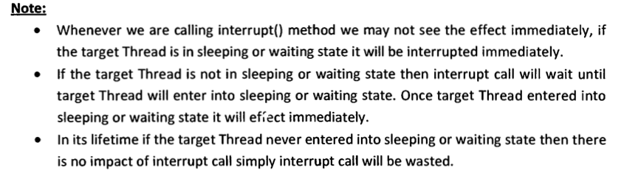
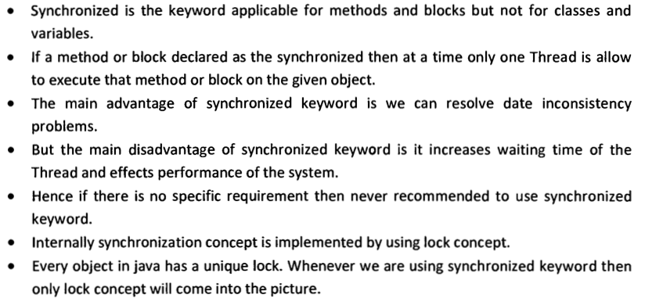

Slide 35
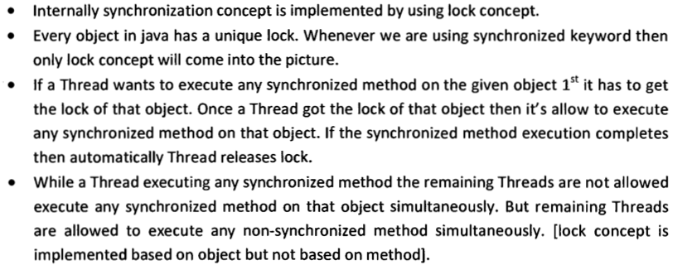

Slide 36
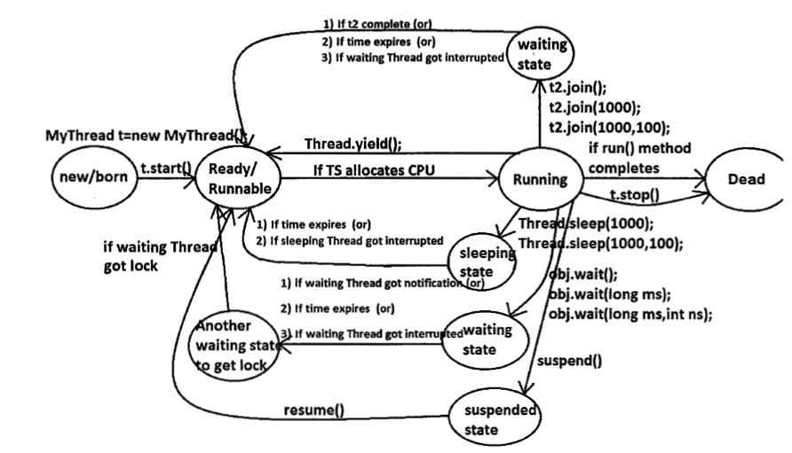

Slide 37
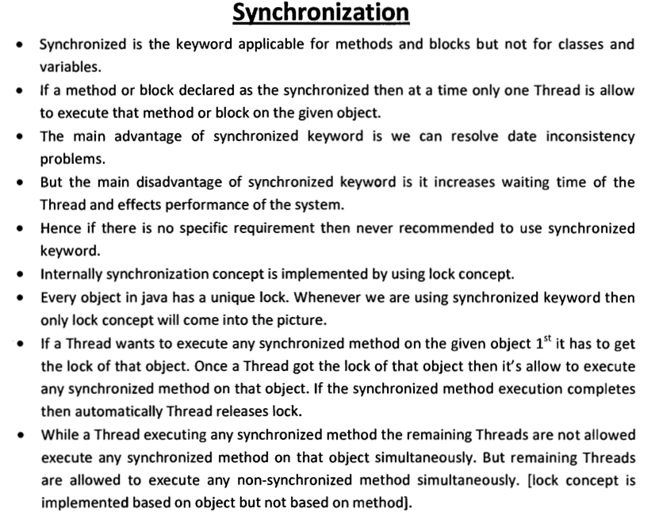

Slide 38
class Display{
public synchronized void wish(String name){
for(int i=0; i<5; i++){
System.out.print("good morning:");
try{
Thread.sleep(1000);
} catch(InterruptedException e){ }
System.out.println(name);
} } }
class MyThread extends Thread{
Display d;
String name;
MyThread(Display d, String name){
this.d = d;
this.name = name;
}
public void run(){
d.wish(name);
} }
class SynchronizedDemo{
public static void main(String[] args){
Display d1 = new Display();
MyThread t1 = new MyThread(d1, "Dhoni");
MyThread t2 = new MyThread(d1, "Yuvraj");
t1.start();
t2.start(); } }

Slide 39
If we are not declaring wish() method as synchronized then both Threads will be executed simultaneously and we will get irregular output.
If we declare wish() method as synchronized then the Threads will be be exected one by one ie until completing 1st thread the 2nd thread will wait.

Slide 40
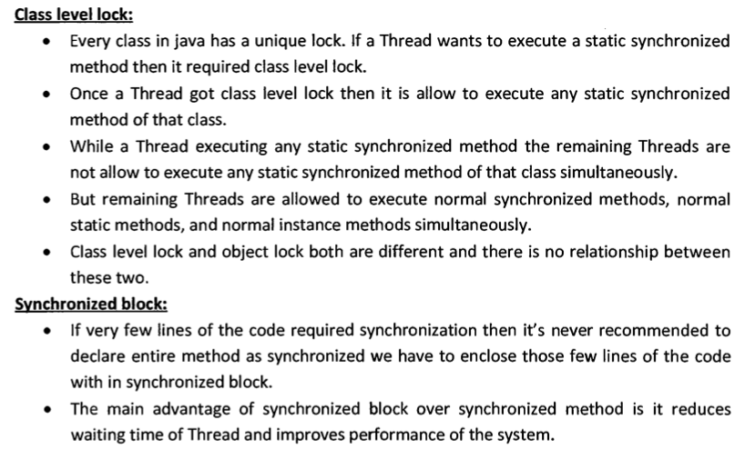

Slide 41
Ex1: to get lock of current object we can declare synchronized block as synchronized(this) { }
Ex2: to get the lock of a particular object ‘obj’ we have to declare a synchronized block as synchronized(obj) { }
Ex3: to get class level lock we have to declare synchronized block as synchronized(Display.class){ }
Note: we can not pass primitive datatype in synchronized as parameter.

Slide 42
THANK
YOU

